Slide 1
Process Improvement Project
Scott Snow
MBC 638
April 2018 – June 2018

Slide 2
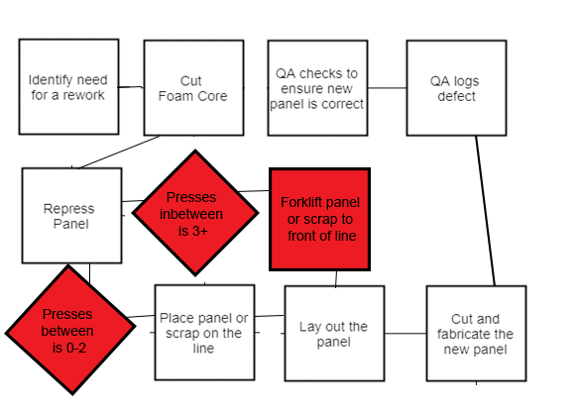
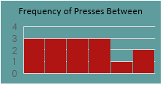
Defect Response Improvement Project
Project Owner: Scott Snow
Key Dates --->
Team
Launch
4/30
Define
4/30 – 5/5
Measure
5/7-6/16
Analyze
6/12-6/17
Improve
6/18-6/19
Control
6/20 -
DEFINE
MEASURE
ANALYZE
IMPROVE
Initial Defect Definition:
Total Time > 25 m
Post Measure Definition: Total Time > 40 minutes.
Breaks down as:
10m to foam, 10m to press and 20m to cut and recheck.
We estimate our average process speed to be defective
What we see initially is larger gaps between foamcut and determine. And recut-press
Changed Items in red
SQL = .93
90% CI for Mu
The Product
When a defect in making this product causes us to have to start over, it is crucial that that restart time be as short as possible
CONTROL
Building new sample to utilize in a 2 sample T-Test
This is what we are hoping to see with our new process
Average: 1 hour 26 min
St. Dev: 51 min
Range: 2 hours 8 minutes
A large part of our improve phase will be to get that range down
Cost = Average Minutes/Panel *Labor
Savings = Reduction in labor costs from increased efficiency
Our regression with these four X’s was quite strong. Our only control sample thus far was different from the estimated value by a factor of 6 to 1
TEAM MEMBERS
Alex, Sarek, Ron, Kris

Slide 3
Define
The goal of this project was to reduce the time we take to rework a defective panel. Since we made a mistake, this rework is essentially free labor for the customer and is something we want to eliminate as much as possible.
Furthermore, a defect is bad for morale which in theory effects speed and quality of product. While our sample didn’t actually support this, a sample of size of 7 is not conclusive.
A defect was defined at the start to be anything greater than 25 minutes for Total Rework Time. During the measure phase, we concluded this to be too ambitious given our current pace and we changed that to greater than 40 minutes.
Our inputs are: Line, Shift, Form Filled, Process Clock Times and:
Presses In between: A line receives presses from the laminator. Once the defect panel is cut, we are measuring how many panels the cutter on the fabrication line cuts before attempting to re-cut the repressed panel. This is to determine how the speed of the fabrication line is effected by the defect.
Speed of day at Time noticed: This is the time of day that the defect was noticed, minus breaks, divided by the number of panels pressed up till that point. This is to determine how the speed of the laminator is effected by a defect.
Speed of day at Time cut: This is the same measurement, just taken when the repress is recut or when it resumes its original place on the line for pre-fabrication defects.

Slide 4
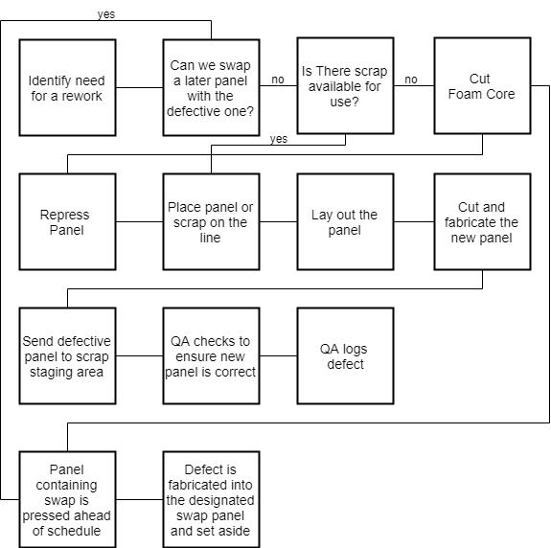
Original Process
Identifying a defect was Tn for Time noticed
Identifying or determining the need for a rework was Td or Time determined
Cutting the foam for the repress was Tf for Time Foam cut
Pressing the rework was Tp or Time Pressed
Re-cutting the rework was Tr or Time Re-cut
As the project want on, Tn to Td and the time after Tr became less important as it became apparent these were separate sub processes that could take varying amounts of time depending on the job, its deadline, materials etc.
Layout, which Is within Tp to Tr, can vary on occasion but it is very rare that a single panel is so complex to actually be the cause of the defect. Most normally, it is either a simple misread of a measuring type or accidently using the wrong angle on a saw

Slide 5
Measure
Our data measurement plan initially consisted of measuring the time gaps between each of 5 overarching process steps: Defect Noticed, Repress Determined, Foam Cut, Panel Pressed, Panel Re-cut or when it resumed its original place. We also recorded discrete information such as which shift, which production line, etc.
Sometimes a defect was noticed before it was cut either in its production detail or in the lamination process
After a few defects occurred where the data wasn’t recorded, I changed the plan to include recording all repress data and including a field for whether the time data was filled out. Out of 15 represses, 7 data sheets were filled.
The time data and the rate of production data was continuous. The panel number data, and the binary shift, line etc. data is discrete.
There was a mixture of collecting new data and getting data that was already recorded. This specifically occurred because the data collection form wasn’t always being filled out and this actually ended up as a testable input.
I collected 15 total samples because that was the total number of represses we had in the 40 day measure span. Of those, I was able to collect, or have collected continuous data for seven samples. This difference likely comes for a lack of communication on my part and a lack of communication in the workplace
After the first 4 continuous samples, and at the end of the measurement phase, I went through our production records to collect all of the discrete data. The continuous data I gathered came from forms I had stored at the QC station that were supposed to be grabbed and stapled to the repress’ production detail to be filled out as the repress made its way through the process.
Measurement error can and probably did occur in filling out the sheets. Since we are in a new building, all of our clocks are analogue and some are in fact off. Additionally, I have no way of ensuring for the sheets where I wasn’t present, that the data wasn’t estimated and filled out after the fact. Of the sheets, I filled out 3 personally, for those sheets I reduced error by using my phone’s clock to record each time.
For our initial target margin of error of five minutes, we came to a sample size of 174 which was much more than we ended up collecting. Changing the numbers to match our sample size we found that we had enough data to be 90% confident with a margin of error of 25 minutes. If I had been able to get continuous data for every repress, that would have dropped our margin of error to 17 minutes unless that additional data drastically changed our standard deviation.

Slide 6
Analyze
Tools Used
We are doing 2 two-sample T-tests, 1 determine whether there is in fact a slow down after a defect occurs, and the other to determine whether our new process actually made a difference. For the speed difference test we failed to reject H0.
We wished to use a Chi-Squared test of independence for our discrete variables. Unfortunately, significant results require at most 20% of Expected values to be less than 5. We were not able to achieve this for any combination of discrete data since each table was 2 by 2. Instead we checked for correlation between Presses in between the original and the repress, and the total rework time. This yielded a correlation of .309. There is some but not enough to be statistically relevant. We also checked correlation between pressed in between and stacks from original of .716.
Since we were unable to get continuous data for all of our represses, we used a confidence interval of 90% for that population average. We are 90% confident that the average would have been between 58 and 133 minutes if we had gotten data for every repress.
To check to see how all of our variable interacted, we performed multiple regression on four of our inputs. In this process, we did attempt to remove some of the values to see if we got similar R values. Unfortunately, each time we removed something, we got a significantly lower R value. Our r value for all four inputs was .922 and our average p value for each coefficient and our intercept was .65. This is somewhat low, but it will still be a decent tool in estimating our success.
Finally, to help us visualize our data and determine the successfulness of our improvements, we set up an Individual xBar control charts for each of the three time gaps that we care about and for Total Rework Time. Unfortunately, any new data won’t have the potential to cause a clear indication of improvement since our lower control limit was negative for every chart. However, we will be able to take our next sample and plot them on our graph to see where they lay and to see if our process becomes our of control and a positive way.

Slide 7
Improve
For improvements, we sought to decrease each time zone to as close to 10 minutes,10 minutes, and 20 minutes as possible. We established 20 minutes as close to the quickest time possible for a repress that was defective pre fabrication and 25 minutes as the quickest time for a defect during fabrication.
We sought to make these changes without affecting speed.
Our changes are two fold:
The determination needs to be efficient and once the size necessary is determined, the detail is double checked once, and then sent to the foam area for cutting. We have two foam tables so the cutters are able to stop whatever they were cutting and then quickly cut the repress on the other table.
If the defect was noticed and determined three or more panels prior, the repress needs to be the next panel that is pressed and then it needs to be carried or forklifted to the front of the line.
If not (usually on a very quick paced day) it can simply be pressed and placed on the line in its natural order.
Additionally, we made a notice to improve communication if a defect occurs at the end of a shift such that it has to be repressed the next day.

Slide 8
Control
For control we have three methods to determine if we achieved improvement:
We can visually inspect the process control chart and plot new data to determine if our process is becoming unstable.
We can utilize our regression equation to compare our actual Total rework time to the estimated Total rework time. If we continually see actual times less than the estimated time, this is strong indication that we have made a difference.
Once we obtain enough samples, we can complete the two sample T-test to see whether we reject the null hypothesis: There is no statistically relevant change in total rework time.
So far, we have only had two represses in our control phase.
The first defect occurred pre-fabrication so the total rework time was only 23 minutes. Based on the conditions present when it occurred, this compares very well to a regression estimated time of 97 minutes.
This data point is also well below the center line on each individual ImR chart and on the Total ImR chart
Our second data point was from a defect that had occurred the previous day. Unfortunately, one of your regression inputs isn’t available in that case.
This did however allow us to attempt our 2 sample T test, based on those two results we looked for a confidence level of 90%. This would mean alpha = .10. Our T-value was -0.73 which resulted in a P-value of .24. Since .24 > .10, we failed to reject the null.
We are hopeful that further data will change this conclusion

Slide 9
Conclusions and Thoughts
This project was a great opportunity to improve one of the rare inefficient policies at my job. The company has been around in one way or another for a long time with the same production manager for the last 9 years. Many of its main processes are quite efficient. While many of them could potentially be more efficient, this is one we had wanted to work on for some time.
It is unfortunate that I was unable to utilize the Chi-Squared test for independence. Hidden in the requirement is actually a sample size minimum.
There is a part of me that would go back and choose a different topic that allows me to do all of the collecting by myself and where I could collect more data. The project also taught me that I have more to work on as far as my communication skills go.

